Slide 1
Attacking Smart Irrigation Systems IoT Village @ DefCon 26 11/08/2018
Fujitsu System Integration Laboratories

Slide 2
Who Are We?
Ben Nassi is a Ph.D. student in the Department of Software and Information Systems Engineering at Ben-Gurion University of the Negev and a former Google employee. His Ph.D. topic is titled, "Cyber security in the IoT era."
Moshe Sror is a security researcher at BGU’s Cyber Security Research Center. He holds a B.Sc. in software and information systems engineering from Ben-Gurion University of the Negev.
Dr. Asaf Shabtai is an assistant professor in the Department of Software and Information Systems Engineering at Ben-Gurion University of the Negev (BGU).
Prof. Yuval Elovici is the director of the Telekom Innovation Laboratories at Ben-Gurion University of the Negev, head of BGU’s Cyber Security Research Center, and a professor in the Department of Software and Information Systems Engineering at BGU.
Fujitsu System Integration Laboratories

Slide 3
Agenda
Smart Irrigation Systems
Reverse Engineering
Spoofing Attacks
Replay Attacks
Discussion

Slide 4
Irrigation Systems – History & Evolution
Up to 2012
Traditional
irrigation systems
2013
Smart irrigation systems appear
2016
First smart city adopts smart irrigation systems
Today
Many vendors
Many connected sensors
GSM editions

Slide 5
Smart Irrigation Systems
Smart irrigation systems are advanced irrigation systems that incorporate various sensors and network components for increased efficiency in order to save water and money.
Connected to the Internet.
Provide remote command & control service.
Allow automatic adaptation of watering plan based on the weather forecast.
Monitor watering plans and water consumption.

Slide 6
Motivation for Buying Smart Irrigation Systems
Low price
Green technology
Very convenient UI
Remote control capability from smartphones, PCs, etc.
Enable sensor connectivity
Wireless connectivity (Wi-Fi and GSM)

Slide 7
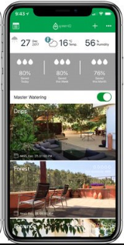
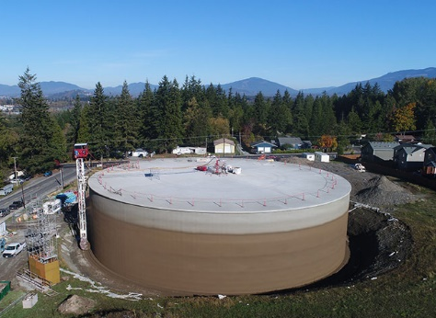
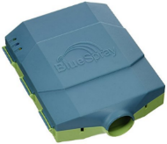
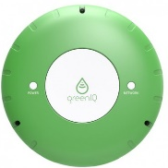
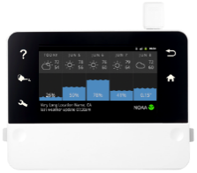
Ecosystem
C&C Devices
Water Reservoir
Smart Irrigation Systems
Sensors
Cloud Server
Valves
Weather Forecast Servers

Slide 8
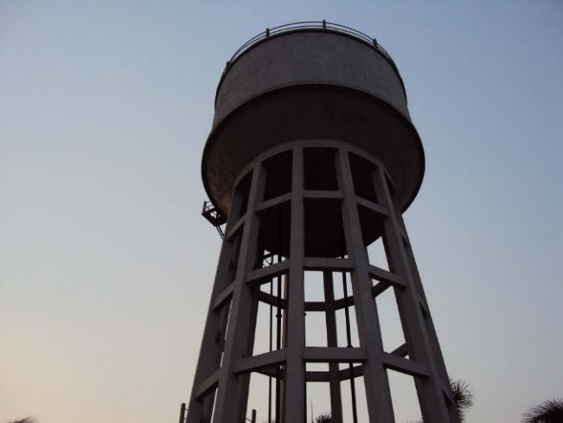
Reasons to Attack Them
They are connected to critical infrastructure (urban/national water service).
To cause financial harm to a party as a result of overconsumption of water (for example, the average combined water tariff in Portland, Oregon is $8.00 $m^{3})$.

Slide 9
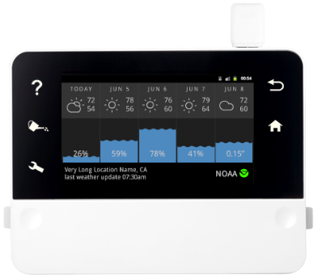
Commercial Smart Irrigation Systems Investigated
RainMachine
BlueSpray
GreenIQ (2nd Generation)
Costs $249 on Amazon
Touch HD Screen
Up to 16 Zones
Wi-Fi
Costs $205 on Amazon
Up to 16 Zones
Wi-Fi
Costs $200 on Amazon
6 Zones
Wi-Fi

Slide 10
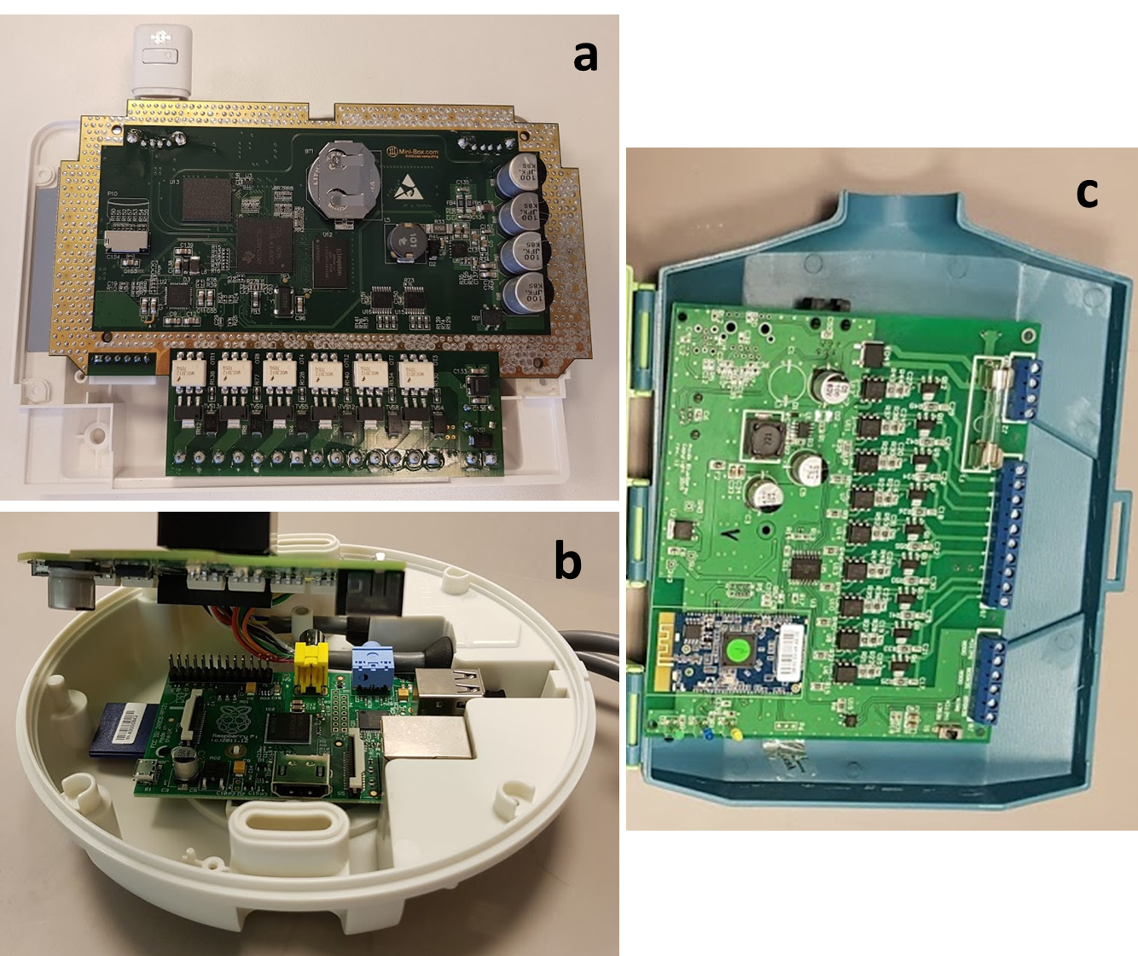
Reverse Engineering
Extracting Firmware
GreenIQ - We downloaded the firmware from its microcontroller’s (Raspberry Pi 2) SD card to our computer using an SD card reader.
RainMachine - We downloaded the firmware (using UART) to a USB cable.
Analysis - Capturing Network Traffic Using Wireshark
GreenIQ
RainMachine
BlueSpray
(a) RainMachine, (b) GreenIQ, (c) BlueSpray

Slide 11
Spoofing Attacks
Spoofing Attack (definition) - a situation in which a person or program successfully masquerades as another by falsifying data, in order to gain illegitimate advantage.
Purpose
To change the input of a smart irrigation system in order to water according to the attacker's wishes.
Execution
By performing MITM attacks using a bot running on a compromised device that is connected to the same LAN.

Slide 12
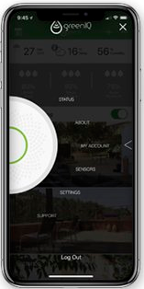
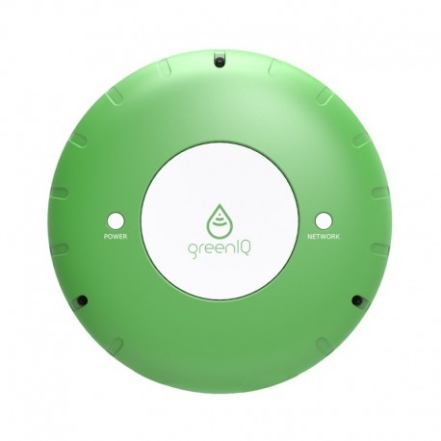
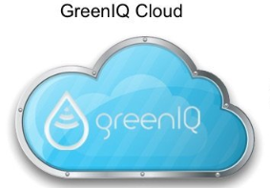
Spoofing Smart Irrigation System Configuration
A dedicated cloud server is used to provide C&C communication between a device (e.g., smartphone) and GreenIQ.
A session between GreenIQ and the cloud server is initiated every minute.
HTTPS
HTTP
HTTPS

Slide 13
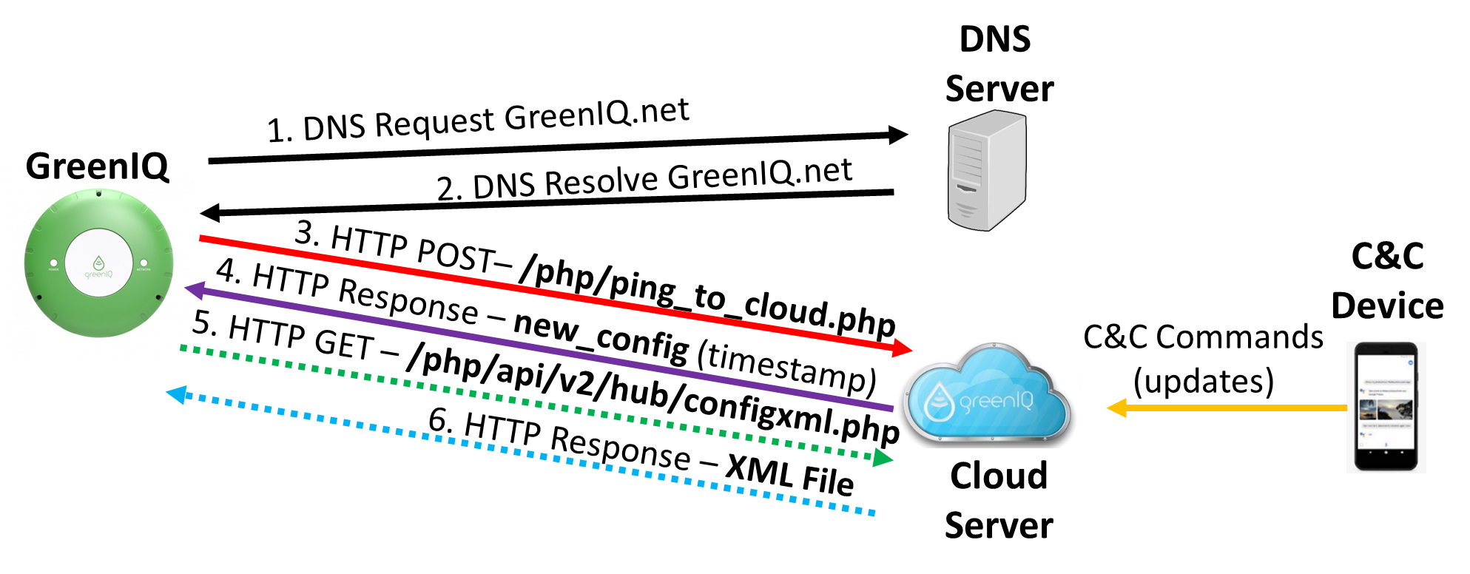
Vulnerability Description
GreenIQ sends an HTTP ping to the cloud server every minute, which is followed by an HTTP response with the timestamp of the last time the user changed the watering plan.
If the timestamp received doesn't match the one that is stored on GreenIQ (as a result of a user update), GreenIQ sends another HTTP request for the new watering plan, which is followed by an HTTP response sent from the cloud server.

Slide 14
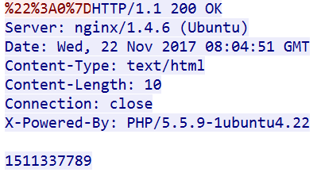
Vulnerability Description
3. HTTP Request – Last User Update
Cloud
Server
GreenIQ
4. HTTP Response – 1511337789
Request
GreenIQ sends a ping every minute with its device ID.
Response
The server sends the timestamp of the last time the watering plan was updated.
Device ID
Timestamp

Slide 15
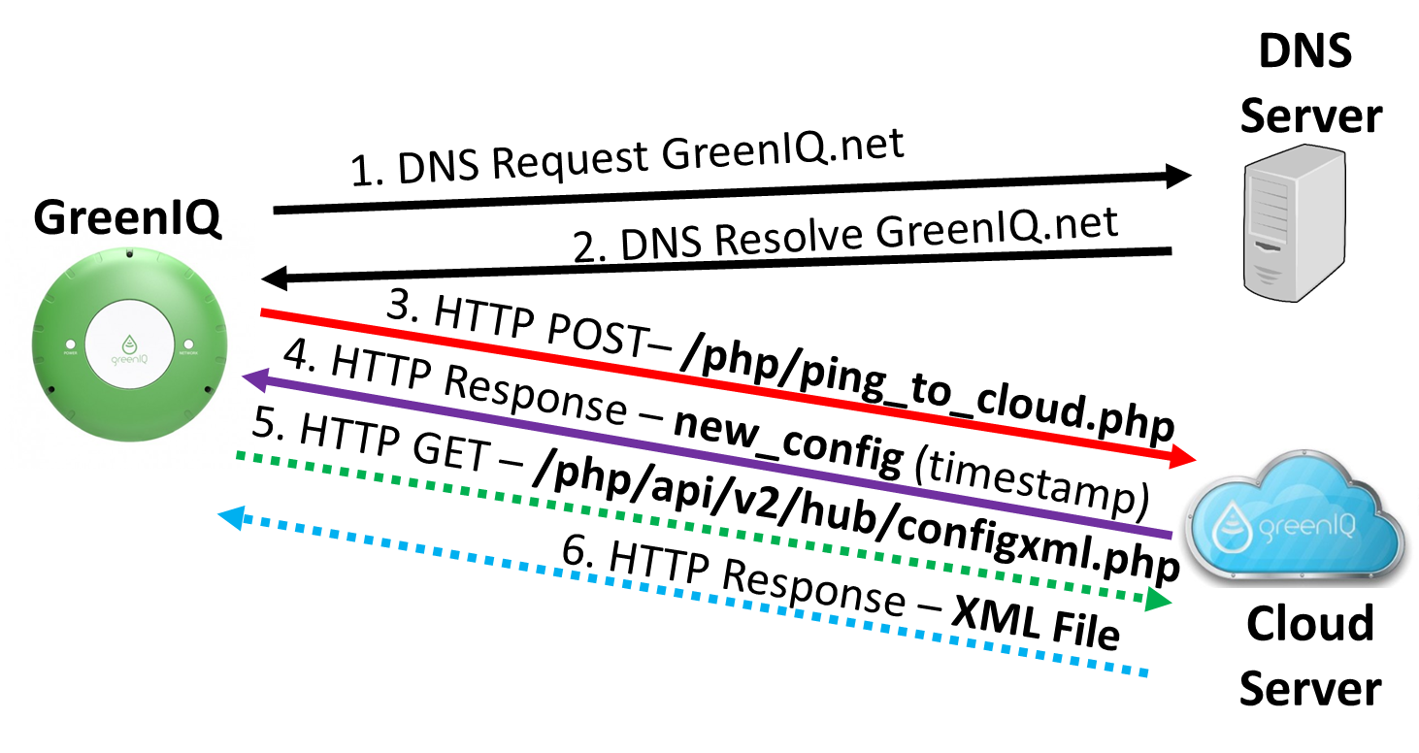
Vulnerability Description
Code from GreenIQ’s firmware

Slide 16
Vulnerability Description
5. HTTP Request – (GET) Watering Plan
Cloud
Server
GreenIQ
6. HTTP Response – XML File
Request
GreenIQ requests the new plan and sends its ID.
Response
The server sends an XML file that contains the user’s information, plans, and configurations.
Device ID

Slide 17
Vulnerability Description
6. HTTP Response – XML File
Cloud
Server
GreenIQ
<?xml version="1.0"?>
<config>
<cmdtime>1526499639</cmdtime>
<master_irrigation>On</master_irrigation>
<data_path>php/users/3720b01effe92174aa55f0cb6fcb82a08cd3ef06d8925e4c458c6839/</data_path>
<weather_dependancy>False</weather_dependancy>
<schedule>
<weekdays>1111111</weekdays> # which days the plan is for
<cycle_period>
<every_x_days>1</every_x_days>
<every_x_hours>2</every_x_hours>
<every_x_minutes>2</every_x_minutes>
</cycle_period>
</schedule>
</config>
<!-- MD5 Signature: 09d13f1c781699fb498c1471f3b8293a -->
Valid MD5
MD5
Plan Changed!

Slide 18
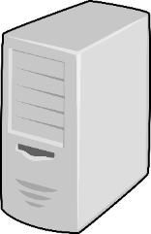
Exploitations and Demo
DNS Spoofing
Injecting Watering Plans
Applying an MITM attack to hijack a request that is sent to GreenIQ’s cloud server.
Sending a newer update time (current time) than the time that is stored on the smart irrigation system.
Sending a fake XML of a watering plan that consumes water all day long.
1. DNS Request - GreenIQ.net
Fake
DNS Server
2. DNS Resolve - GreenIQ.net
GreenIQ
3. HTTP Request – Last User Update
4. HTTP Response –
Current Timestamp
Fake
GreenIQ Cloud Server
5. HTTP Request –
(GET) Watering Plan
6. HTTP Response –
XML File

Slide 19
Permanent Denial of Service
DNS Spoofing
Code from GreenIQ’s firmware
1. DNS Request - GreenIQ.net
Fake
DNS Server
2. DNS Resolve - GreenIQ.net
GreenIQ
3. HTTP Request – Last User Update
4. HTTP Response –
Current Timestamp
Fake
GreenIQ Cloud Server
5. HTTP Request –
(GET) Watering Plan
6. HTTP Response –
XML File

Slide 20
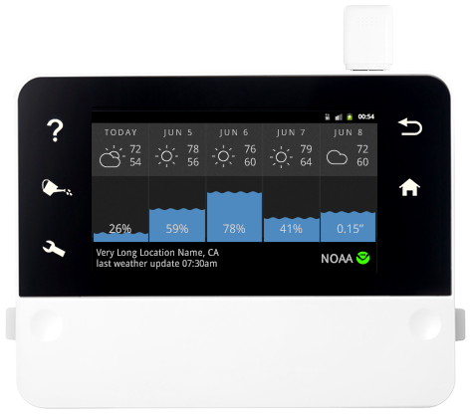
Spoofing Weather Forecast
A smart irrigation system automatically adapts its watering plan according to the weather forecast obtained from weather forecast services.
Every 6 hours a weather forecast request is sent to the weather forecast server.
HTTP

Slide 21
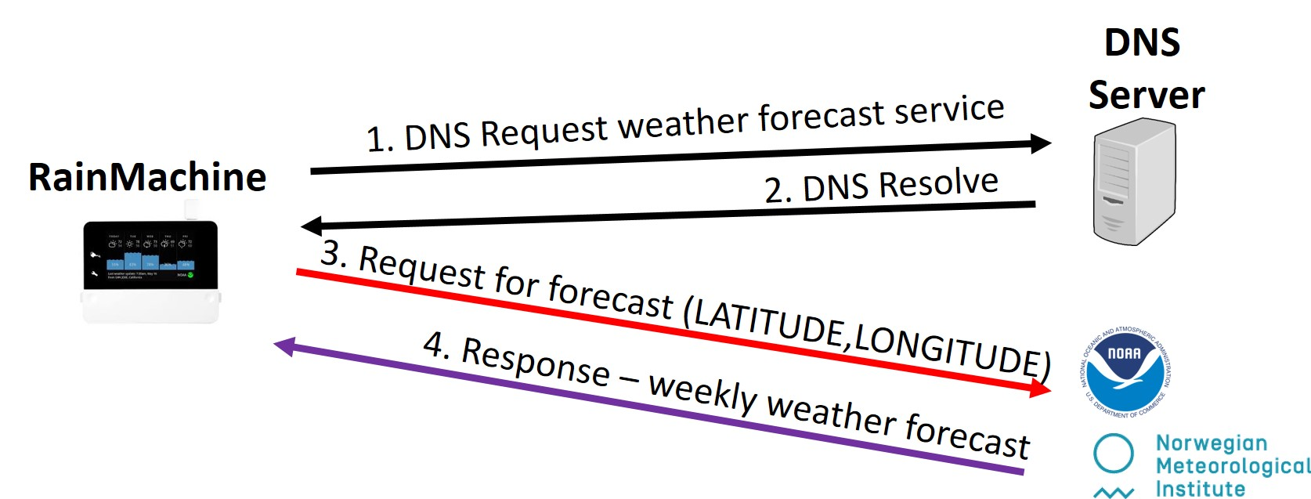
Vulnerability Description
RainMachine automatically adapts its watering plan according to the weather forecast in order to save water.

Slide 22
Vulnerability Description
3. HTTP Request Longitude, Latitude
Weather
Forecast
Server
RainMachine
4. HTTP Response – Weekly Weather Forecast
Request
The client requests a weather forecast from Met.no (weather forecast service) and specifies its GPS coordination.
Response
The server sends an XML file that contains the weather forecast (temperature, humidity, etc.) at hourly resolution.

Slide 23
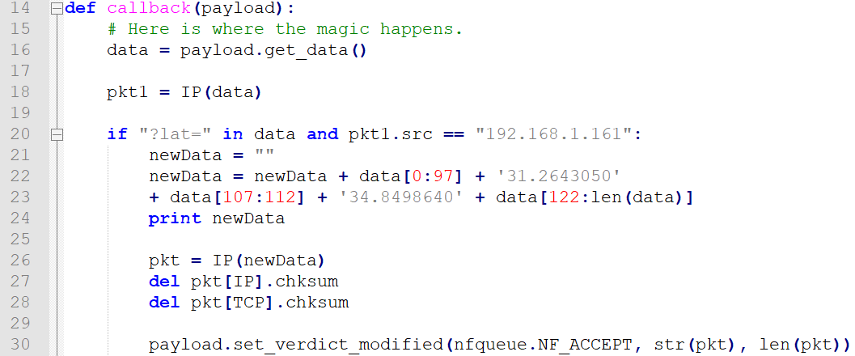
Exploitations and Demo
Request Location Spoofing
Applying an MITM attack for spoofing the location (so the location appears as if it is the most arid place on Earth).
Response Spoofing
Applying an MITM attack for spoofing the forecast weather (so the forecast is incorrect).

Slide 24
Replay Attacks
Replay Attack (definition) - a form of network attack in which a valid data transmission is maliciously or fraudulently transmitted.
Purpose
To exploit a legitimate HMI interface for C&C as a means of attack in order to water according to the attacker's wishes.
Execution
By applying the attack from a bot running on a compromised device that is connected to the same LAN as the smart irrigation system.

Slide 25
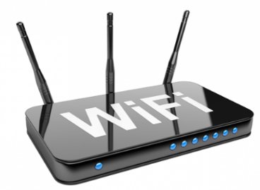
Vulnerability Description
BlueSpray provides HMI using a dedicated web interface that is based on HTTP protcol to devices that are connected to its LAN.
It allows the user to schedule watering plans.
No encryption (HTTP protocol) or authentication is applied.
LAN (Home Network)
HTTP
HTTP

Slide 26
Format of Schedule Watering Request
Scheduling watering - JSON format
{"action":"set",
"data":[{"enabled":1,"type":2,"program":10,"rpt":[0],"season":0,"cycle":[5,60],"name":"New run","start_date":"2018-06-17","start_time":0,"id":5,"flag":"change"}],
"msgid":77080}

Slide 27
Exploitations and Demo
Generating HTTP request for scheduling watering

Slide 28
Vulnerability Description
Opening Valves - The following code was extracted from GreenIQ’s firmware (greeniq_defs.py):
(221) def set_gpio(MAX_PORTS, gpio_map, gpio_command, high_is):
(222) global model_utilities
(223) model_utilities.set_gpio(MAX_PORTS, gpio_map, gpio_command, high_is)
(427) # Testing - Operate Master Valve
(428) set_gpio(MAX_PORTS, gpio_map, '00000010', high_is)

Slide 29
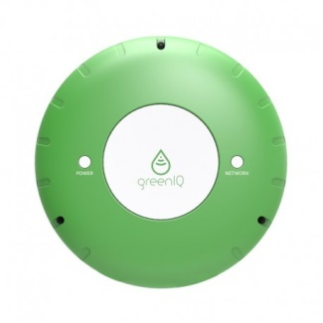
Exploitations and Demo
LAN (Home Network)
SSH
SSH
Assuming (1) the SSH password is too weak or has been leaked, or (2) the smart irrigation itself is compromised.
Opening valves with SSH communication.

Slide 30
DDoS Attack Against Urban Water Service
Threat Model
C&C model - botnet of smart irrigation systems
Initiating watering from many smart irrigation systems simultaneously

Slide 31
The Damage
A typical sprinkler’s water ﬂow is between 0.66 and 4.93 cubic meters per hour (2.795 cubic meters on average)
What is the damage incurred when the attack is performed using a botnet of smart irrigation system that are triggered to water simultaneously?

Slide 32
Ethics
We provided full ethical disclosure of the each of the vulnerabilities that are discussed in this section to GreenIQ, RainMachine, and BlueSpray in June 2018, conveying all of the relevant technical details and some suggestions for addressing the issues raised.
We received a confirmation of our findings from each of them.
GreenIQ - GreenIQ thanked us for our findings and decided to apply HTTPS communication between their smart irrigation system and cloud server. In addition, they decided to close the SSH port in their firmware to prevent an attacker from running Python code for watering.
RainMachine - In June 2018, the Norwegian Meteorological Institute (Met.no) finally upgraded their API to an HTTPS version (replacing the previously used HTTP version). However, other weather forecast services are still HTTP based.
BlueSpray - BlueSpray responded by asking us to supply details regarding the vulnerability.

