Slide 1
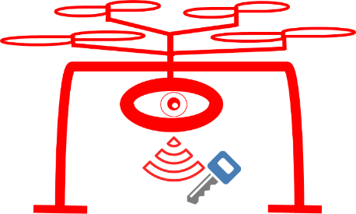
Drones’
Cryptanalysis
Ben Nassi Raz Ben-Netanel
Prof. Adi Shamir Prof. Yuval Elovici

Slide 2
Agenda
Motivation
Detection Scheme
Wi-Fi FPV and Video Compression
FPV Channel Classification
Detecting Whether an FPV Channel is Being Used to Spy on a Victim
Locating a Spying Drone in Space
Hiding the Flicker from the Drone’s Operator
Evaluation in Real Scenarios

Slide 3
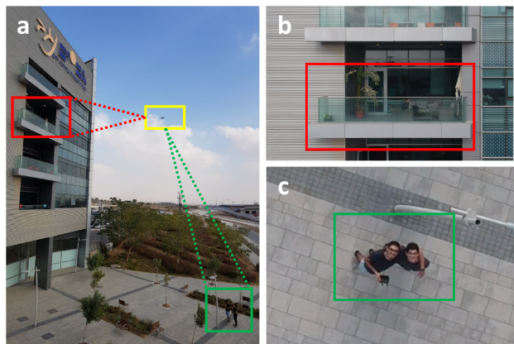
Research Question
In an "Open Skies" era in which drones can ﬂy between us, a new challenge arises: how can we determine whether a drone that is passing near a house is being used by its operator for a legitimate purpose (e.g., delivering pizza) or an illegitimate purpose (e.g., spying on an organization)?

Slide 4
Drones Create a New Threat to Privacy

Slide 5
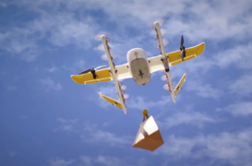
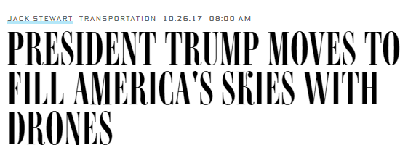
Drone Adoption Rates Increase Around the World
Drone Adoption Businesses around the world have started to adopt drones for various purposes (e.g., deliveries).
“Open Skies” Policy Regulations are being changed, allowing drones to fly in populated areas (adopting an “Open Skies” Policy in cities).

Slide 6
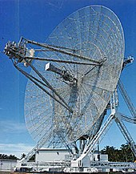
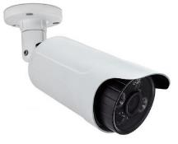
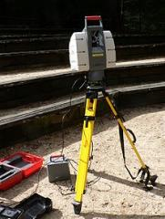
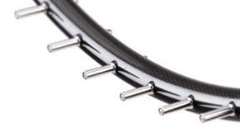
Geofencing Methods for Drone Detection
Radar
Camera
LiDAR
Microphone Array
These methods are able to detect the presence of nearby drones.

Slide 7
Geofencing Methods for Drone Detection
Do Geofencing methods effective at detecting a privacy invasion attack?
The presence of drones is no longer restricted in populated areas.
The difference between legitimate use of a drone and illegitimate use depends on the drone’s camera orientation rather than on the drone’s location.
Geofencing methods are irrelevant for detecting a privacy invasion attack in the “Open Skies” era.

Slide 8
Objective
Main Objective: Detecting a privacy invasion attack.
Classifying a suspicious radio transmission as an FPV channel.
Detecting an FPV channel’s quality (FPS and resolution).
Detecting whether an FPV channel is being used to spy on a victim (even if the victim is not static).
Locating a spying drone in space.
Detecting a privacy invasion attack without the awareness of the drone’s operator.

Slide 9
Agenda
Motivation
Detection Scheme
Wi-Fi FPV and Video Compression
FPV Channel Classification
Detecting Whether an FPV Channel is Being Used to Spy on a Victim
Locating a Spying Drone in Space
Hiding the Flicker from the Drone’s Operator
Evaluation in Real Scenarios

Slide 10
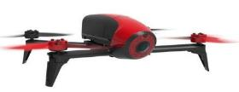
Target Detection Scheme
Wi-Fi FPV Channel
Malicious Drone Operator
Victim
Spying
Detection
Mechanism
Watermarker
Assumptions:
The attacker is using a Wi-Fi FPV drone (located in a range of up to 5 KM from the victim).
The spy detection mechanism is connected to an RF scanner with a proper antenna for intercepting suspicious radio transmissions.

Slide 11
Agenda
Motivation
Detection Scheme
Wi-Fi FPV and Video Compression
FPV Channel Classification
Detecting Whether an FPV Channel is Being Used to Spy on a Victim
Locating a Spying Drone in Space
Hiding the Flicker from the Drone’s Operator
Evaluation in Real Scenarios

Slide 12
Wi-Fi First-Person View Channel
Wi-Fi First-Person View (FPV) Channel - a communication channel based on Wi-Fi communication designed to:
Stream the video captured by the drone’s video camera to the operator’s controller.
Maneuver the drone.
Downlink - Video Streaming
Optical Sensor Capturing
Binary Representation
Video
Encoder
Encryption
Modulation
Air
Modulation
Encryption
Maneuvering Commands
Ground
Uplink - Commands

Slide 13
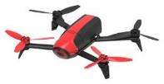
Wi-Fi FPV Channel
OSI Model - DJI Spark
Distance up to 5 KM (FCC compliance)
Most commonly used type of FPV, because it eliminates the need for using a dedicated controller (any devices with a Wi-Fi NIC can be used as controller)
Examples of Wi-Fi FPV drones include:
Layer 7 - Application
Linux
Layer 6 - Presentation
RTP
Layer 5 - Session
Layer 4 - Transport
UDP
Layer 3 - IP
IPv4
Layer 2 - Data Link
IEEE 802.11
Layer 1 - Physical
DJI – Mavic Air
DJI Spark
DJI Mavic Pro
Parrot – Bebop 2
GoPro – Karma

Slide 14
Downlink - Video Streaming Channel
Video Streaming
Optical Sensor Capturing
Binary Representation
Video
Encoder
Encryption
Modulation
802.11 Protocol
Video stream is encrypted.
Does encryption ensures confidentiality?

Slide 15
Interception of an FPV Stream
Given a suspicious Wi-Fi transmission, we create an intercepted bitrate signal:
1) Sniffing Wi-Fi Packets
Enabling NIC’s monitoring mode (attack mode)
Sniffing a network using Airmon
2) Extracting a time series signal from unencrypted metadata (2nd layer)
Packet length (frame.len)
Packet arrival time (frame.number)
3) Downsampling (by aggregating time series in a fixed window)
Packet 5
Packet 7
Packet 1
Packet 6
Packet 9
Packet 3
Packet 8
Packet 10
Packet 2
Packet 4
Packet size
Time

Slide 16
Agenda
Motivation
Detection Scheme
Wi-Fi FPV and Video Compression
FPV Channel Classification
Detecting Whether an FPV Channel is Being Used to Spy on a Victim
Locating a Spying Drone in Space
Hiding the Flicker from the Drone’s Operator
Evaluation in Real Scenarios

Slide 17
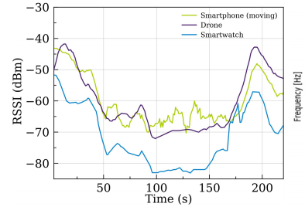
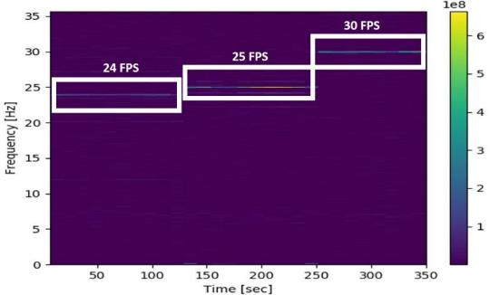
Classifying a Suspicious Transmission as an FPV Channel
Key Observation: A drone is a flying camera.
Moving Device Detection Camera Detection

Slide 18
Classifying a Suspicious Transmission as an FPV Channel
Camera Detection
Analyzing the intercepted bitrate signal in the frequency domain.
Finding the frequency with the maximum magnitude.
Compare the frequency with the maximum magnitude to known frame per second rates of drones {24,25,30,60,96,120}.

Slide 19
Classifying a Suspicious Transmission as an FPV Channel
Moving Object Detection
Analyzing received signal strength indication measurements for a given device (MAC) over time.
Determining that a device is on the move according to measurement changes.

Slide 20
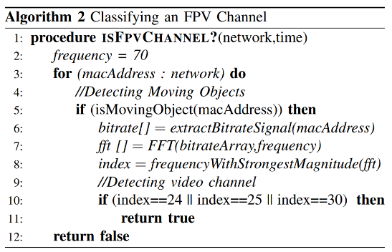
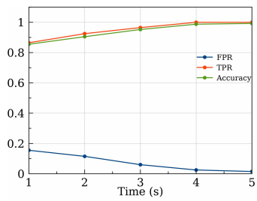
Classifying a Suspicious Transmission as an FPV Channel
We can determine whether a suspicious radio transmission is an FPV channel within 4 seconds with accuracy of 99.9%.

Slide 21
Detecting FPS and Resolution
FPV channel (bits per second) =
Drone to controller traffic (BPS) + Controller to drone traffic (BPS) =
Video stream + Metadata about the transmission + Maneuvering commands + Transmission‘s metadata =
Video stream + O(c) =
FPS x Resolution (Delta resolution) + O(c).
Resolution =
FPV Channel (Bits Per Second)
FPS
By applying FFT to the intercepted bitrate signal of an FPV channel we can detect the FPS and use it to calculate the resolution by analyzing the bitrate per second.

Slide 22
Agenda
Motivation
Detection Scheme
Wi-Fi FPV and Video Compression
FPV Channel Classification
Detecting Whether an FPV Channel is Being Used to Spy on a Victim
Locating a Spying Drone in Space
Hiding the Flicker from the Drone’s Operator
Evaluation in Real Scenarios

Slide 23
Video Compression Stage
Downlink - Video Streaming
Optical Sensor Capturing
Binary Representation
Video
Encoder
Encryption
Modulation
H.264
Standards

Slide 24
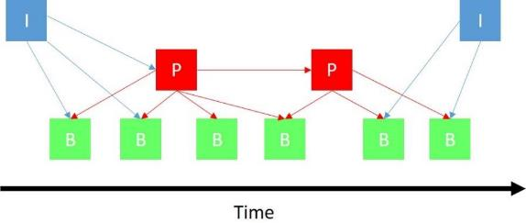
H.264 Compression Standards
Motion Compensation Algorithm
Instead of sending an entire frame, a frame is described as a delta (changes) from another frame, and this information is sent.
Self-Contained Frames (I-Frames)
Delta Frames (B-Frames and P-Frames)
Data is sent in a GOP (group of picture) structure
The result: If there are a lot of changes between two consecutive frames, a lot of data needs to be encoded, so the delta frames are much larger comparing to delta frames of two similar consecutive frames.

Slide 25
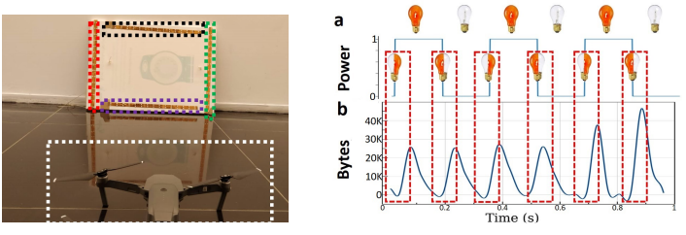
Influence of Periodic Physical Stimulus on the Frequency Domain
Key Observation: a 3 Hz flickering LED created 6 bursts in the intercepted bitrate signal.

Slide 26
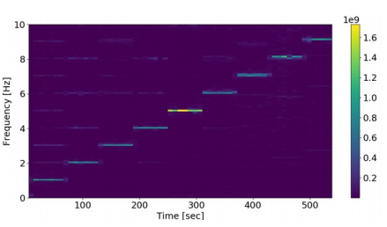
Watermarking a Target Frequency
Detecting whether a specific POI is being streamed by a FPV channel by:
Launching a flicker with a frequency f.
Testing the change of magnitude of frequency 2f of the intercepted bitrate signal in the frequency domain.
Frequency of maximum physical stimulus is limited to 12 Hz (because the minimal FPS rate of a commercial drone is 24 Hz)
We can watermark each and every frequency of the intercepted bitrate signal using a flickering LED.

Slide 27
Agenda
Motivation
Detection Scheme
Wi-Fi FPV and Video Compression
FPV Channel Classification
Detecting Whether an FPV Channel is Being Used to Spy on a Victim
Locating a Spying Drone in Space
Hiding the Flicker from the Drone’s Operator
Evaluation in Real Scenarios

Slide 28
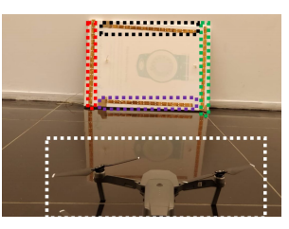
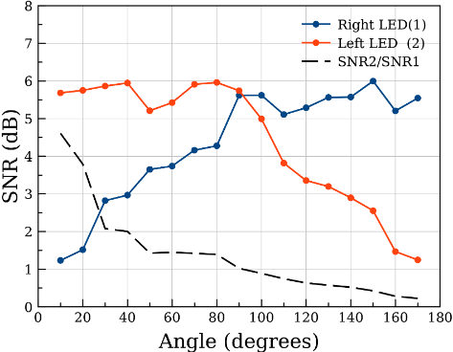
Detecting the Angle Between the Drone and the Target

Slide 29
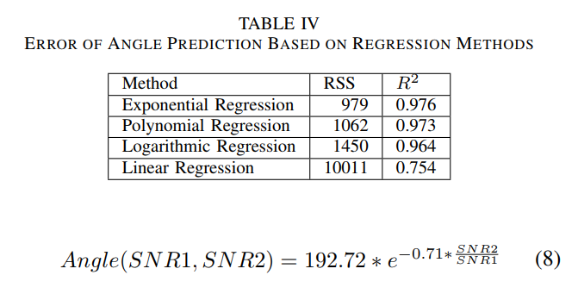
Detecting the Angle Between the Drone and the Target

Slide 30
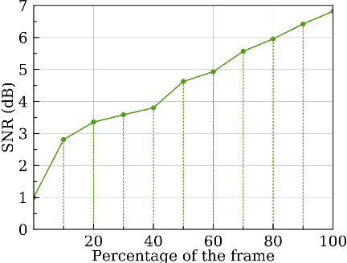
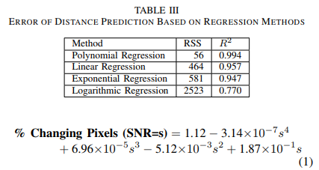
Detecting the Distance Between the Drone and the Target

Slide 31
Detecting the Distance Between the Drone and the Target
Determining the FPV resolution of the FPV channel and finding the image’s height.
Triggering a physical stimulus using a square flicker (size of height x height) at a specific frequency (e.g., 3 Hz).
Calculating the percentage of changing pixels from the intercepted bitrate signal using the equation.
Inferring the number of changing pixels from the FPV resolution.
Inferring object’s height and width (in terms of pixels) of the flickering object in a frame.
Calculating the distance from the drone to the object using dedicated calculators that take the following as input:
Real Object Height (LED Board)
Image Height
Object’s Height in pixels (calculated from the equation)

Slide 32
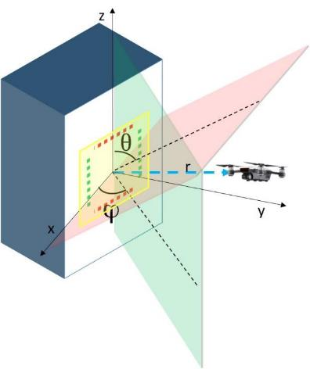
Locating Drones in Space
Calculating spherical coordinates (θ, ϕ,r):
θ and ϕ - using the formula to detect angle.
r - using the formula to detect distance.
Calculating spying drone’s location (longitude, latitude, altitude) from the equations of spherical coordinates (θ, ϕ,r):
x = r sin(θ) cos (ϕ)
y = r sin(θ) sin (ϕ)
z = r cos(θ)

Slide 33
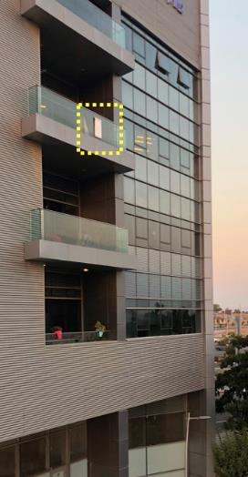
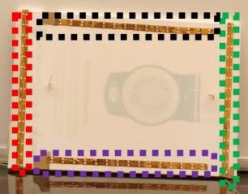
Locating Drones in Space

Slide 34
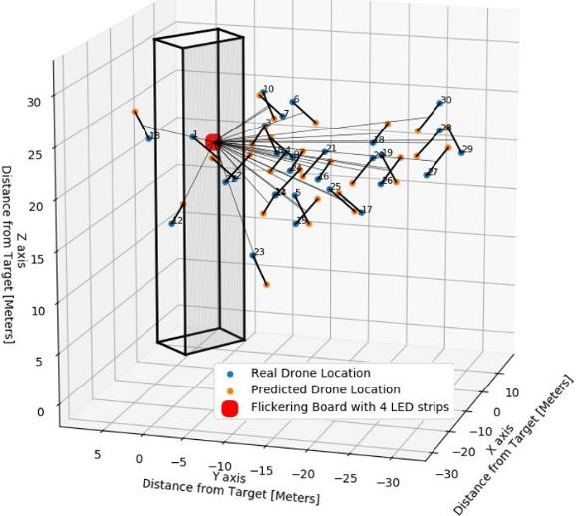
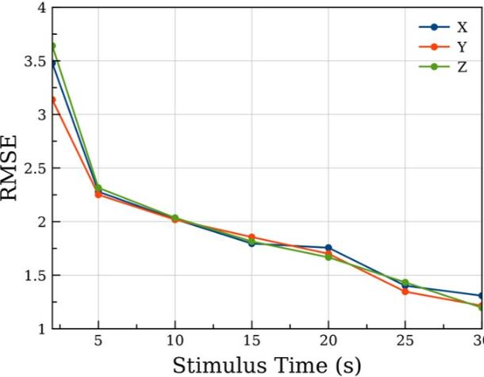
Results

Slide 35
Agenda
Motivation
Detection Scheme
Wi-Fi FPV and Video Compression
FPV Channel Classification
Detecting Whether an FPV Channel is Being Used to Spy on a Victim
Locating a Spying Drone in Space
Hiding the Flicker from the Drone’s Operator
Evaluation in Real Scenarios

Slide 36
Hiding the Physical Stimulus
Objective: Applying the physical stimulus invisibly.
Requirements:
The flicker must be undetectable by direct observation by the drone’s operator
The flicker must be undetectable by indirect observation via the drone’s controller
The flicker must watermark the FPV channel

Slide 37
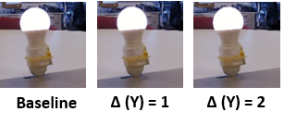
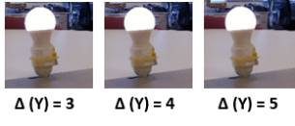
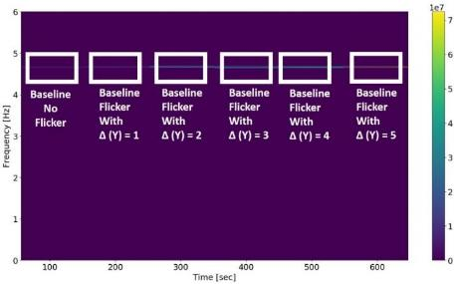
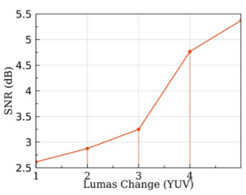
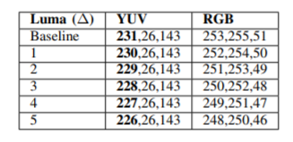
Hiding the Physical Stimulus
Flickering between two similar hues
Undetectable by direct observation
Undetectable by indirect observation
Watermark

Slide 38
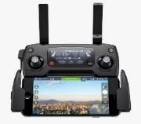
Optional Methods For Hiding the Physical Stimulus That Were Failed
Using an infrared projector
Undetectable by direct observation
Undetectable via the controller
Watermark
Applying the physical stimulus for a period of time that the human eye is unable to perceive (e.g., 10 milliseconds)
Undetectable by direct observation
Undetectable via the controller
Watermark

Slide 39
Analysis of Influence of Ambient Factors
It is better to watermark the frequencies in the range of 6-12 Hz, since the frequencies between 1-6 Hz are noisier.
A combination of an LED strip and a smart film can provide a solution for detecting a drone throughout the day.

Slide 40
Agenda
Motivation
Detection Scheme
Wi-Fi FPV and Video Compression
FPV Channel Classification
Detecting Whether an FPV Channel is Being Used to Spy on a Victim
Locating a Spying Drone in Space
Hiding the Flicker from the Drone’s Operator
Evaluation in Real Scenarios

Slide 41
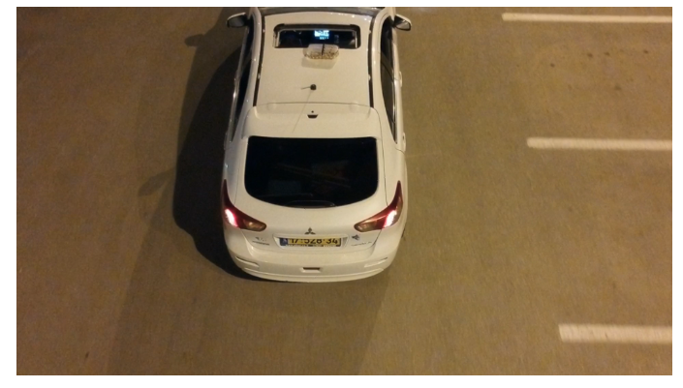
Demos

Slide 42
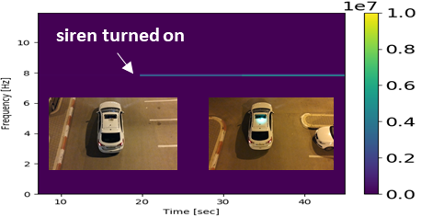
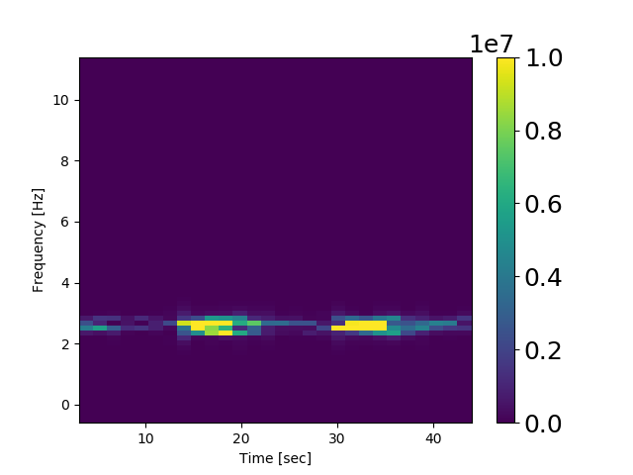
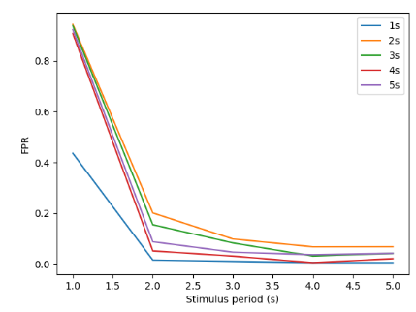
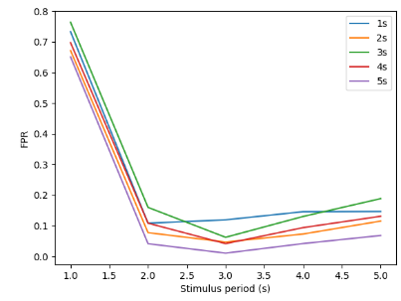
Results
Smart film flickers
Smart film flickers
siren turned on

Slide 43
Misc
Additional Information that can be found In the paper:
Locating the spying drone in space
Countermeasure Methods.
Analysis of the Impact of Ambient Factors (Wind and Light).
Other Methods that we considered for hiding the flicker.
Exact Details of the Experiments.
Others: Preliminary Version of the Paper - Detecting a Privacy Invasion Attack using Time Domain Analysis –“Game of Drones”, on Arxiv.

Slide 44
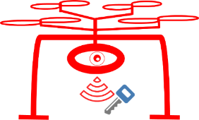
Don’t Forget: The P in IoT stands for Privacy.
@ben_nassi
My Twitter Paper’s Website
Questions???

